Slide 1
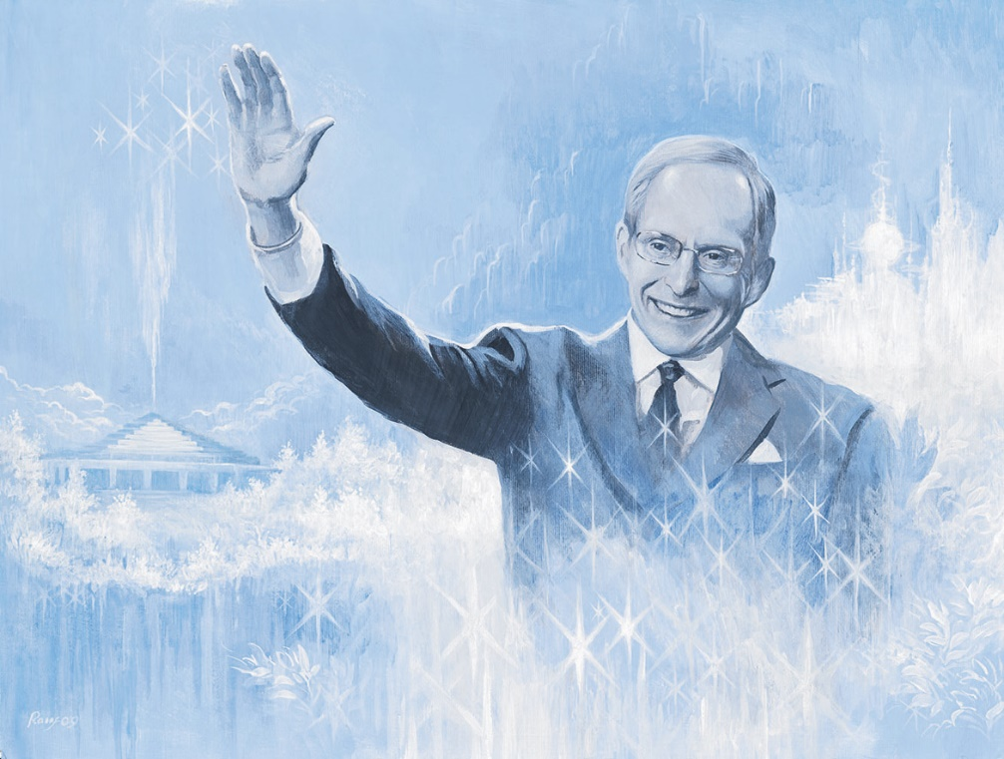
God’s Blessings are Always With You
Click here to enter an event
Click here to enter a date

Slide 2
Blessing

Slide 15
Copyright © 2013 ECKANKAR. All rights reserved. The terms ECKANKAR, ECK, EK, MAHANTA, SOUL TRAVEL, and VAIRAGI, among others, are trademarks of ECKANKAR, PO Box 2000, Chanhassen, MN 55317-2000 USA.
www.Eckankar.org

