Slide 1
Mastering Change in Your Life
changes
changes

Slide 2
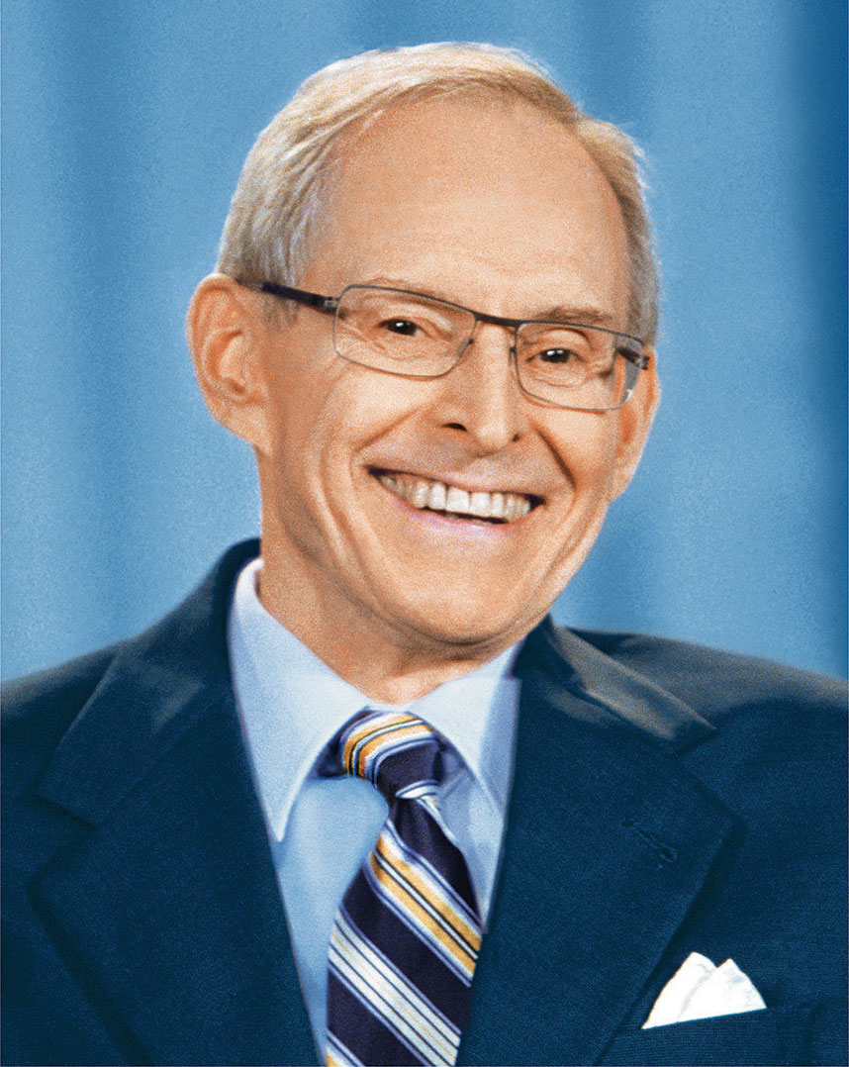
“Change is therefore not to be feared, but to be accepted as an integral part of life. Change strengthens Soul.”
The Law of Change
—Sri Harold Klemp, Eckopedia, p. 38

Slide 3
What is a spiritual skill you use for coping with change?

Slide 4
“Look at the situation from above, from the Soul perspective. Imagine yourself gently floating down into the situation using a golden parachute. The parachute is being guided by the Mahanta and is carrying you safely into the situation with love and grace. With the Mahanta by your side, imagine yourself learning whatever you need to learn and doing whatever you need to do.”
The Golden Parachute
—Sri Harold Klemp, The Wonder within You, p. 43

Slide 5
Collage Activity
Choose images that show what you hope to learn and do to grow spiritually from this change in your life.

Slide 6
Gratitude Letter to the Mahanta
Write a letter to the Mahanta as if your change has already happened. You can share your gratitude for the gifts it brought and the lessons you learned.

