Slide 1



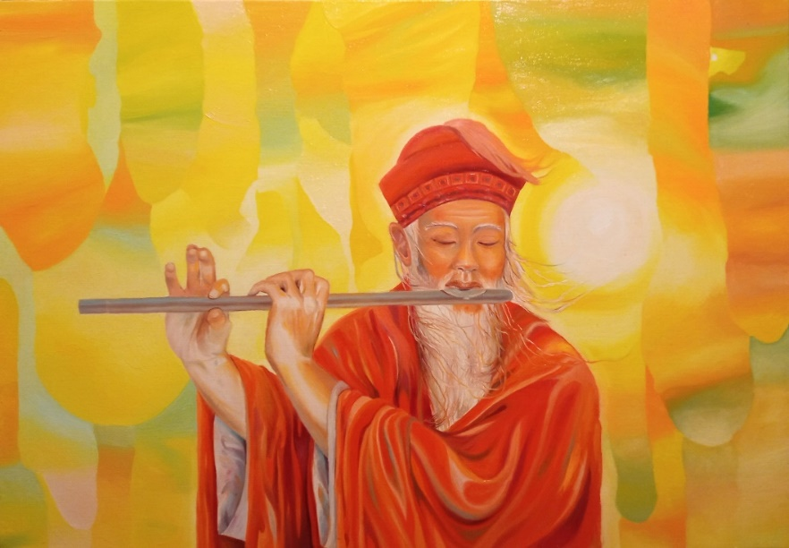


Slide 2

Which fun facts did you already know? Which were new to you?
Which were the most interesting to you?
Did you relate to any of the experiences
in the artwork?
How have you experienced the Light and/or the Sound?

Slide 3

The Light is the Holy Spirit at a certain
rate of vibration where the atoms of God can be seen.
At a higher, faster vibration, It can be
heard as the Sound Current of ECK.
—Adapted from Harold Klemp,
Unlocking Your Sacred Puzzle Box, p. 159

Slide 4

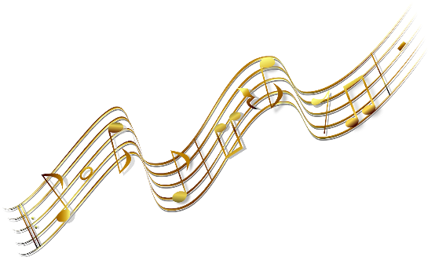
Listen for HU in the sound of the instruments.
See if you can feel the Sound Current moving through you.
Where do you feel the music the most?
Does each instrument have the same vibration?
What other sounds do you hear?

Slide 5
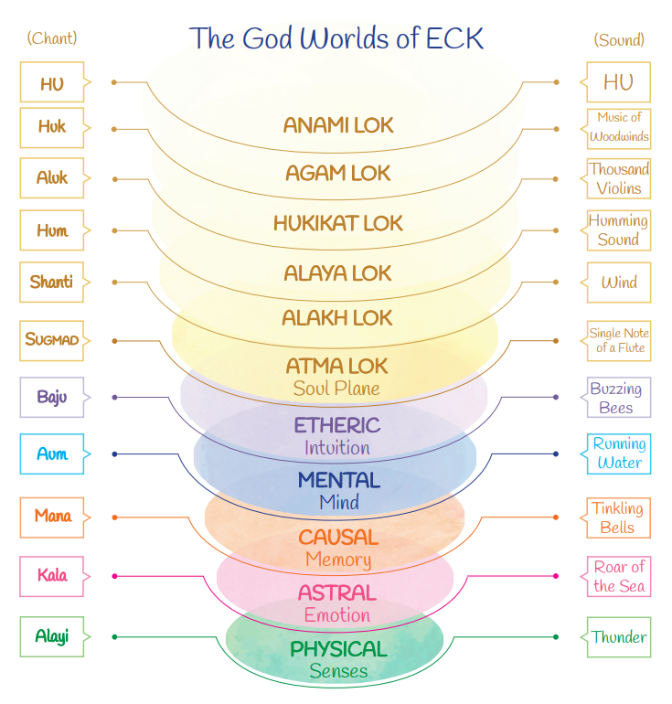

Slide 6


Slide 7
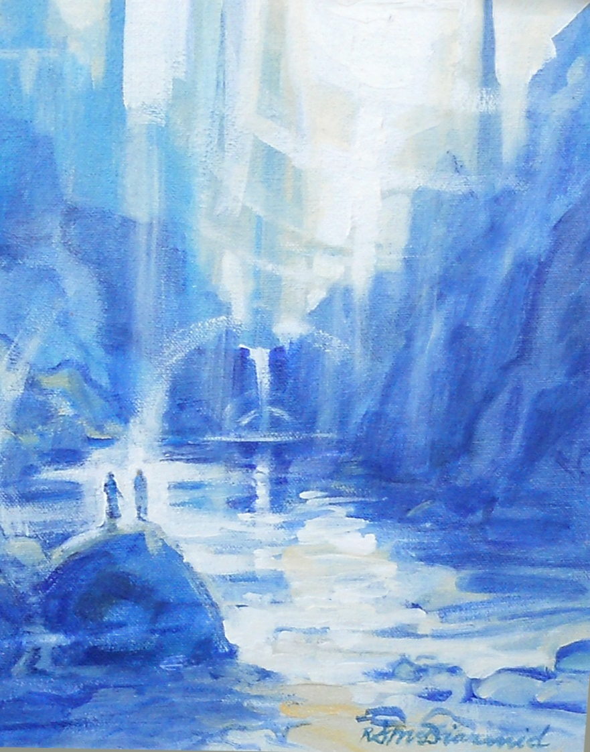

Slide 8


Slide 9


Slide 10
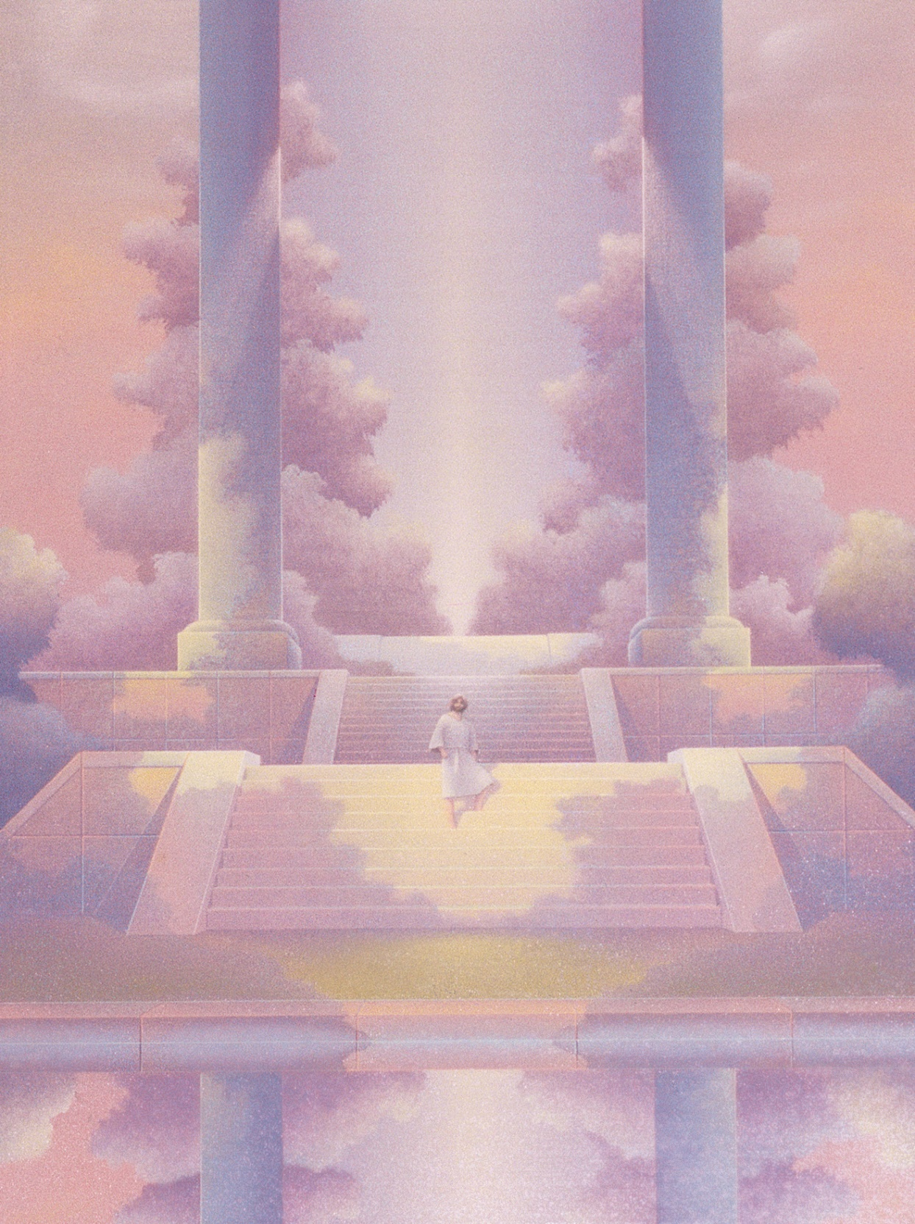


Slide 12


Slide 13
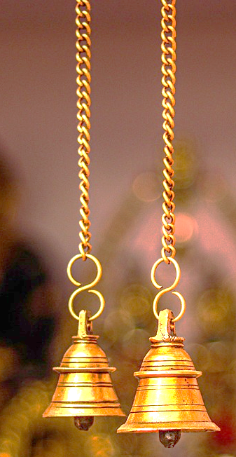

Slide 15


Slide 16

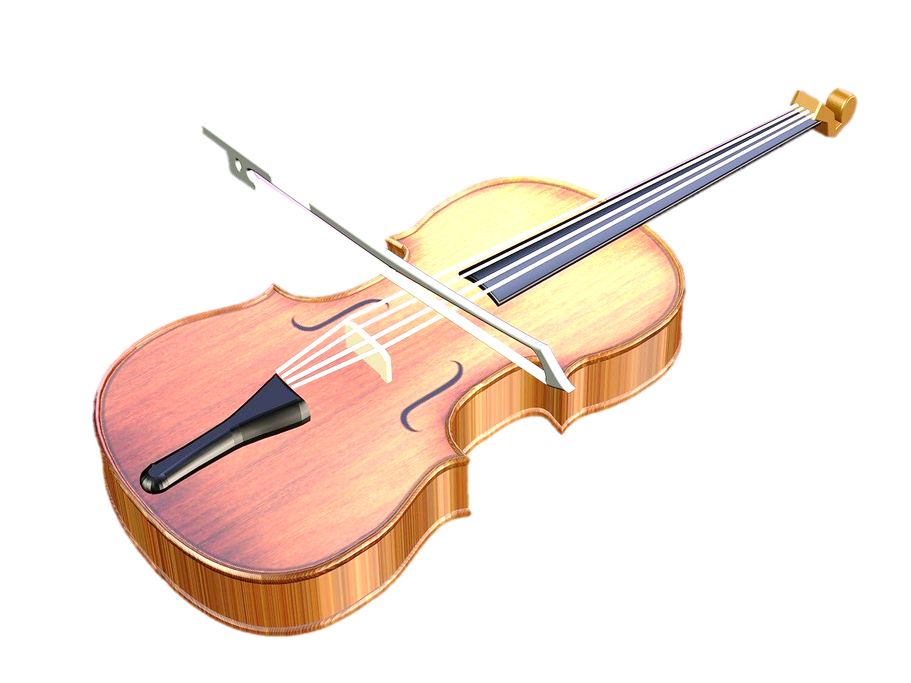

Slide 18


Slide 19
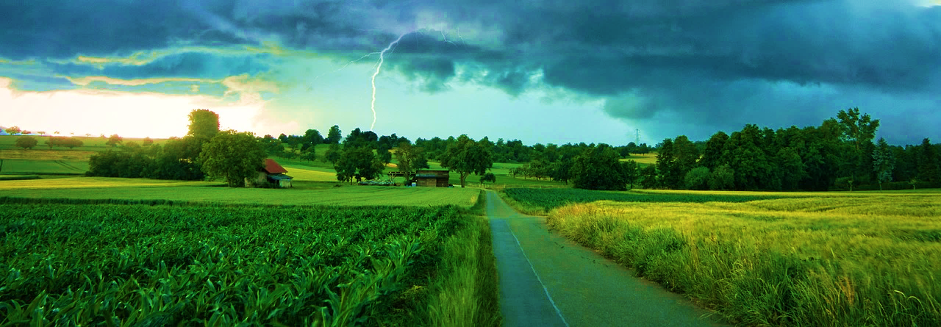

Slide 21


Slide 22


Slide 24


Slide 25
“When you sing HU, know that this is one of the most sacred names for God. Sing it with love….Look for the Light, listen for the Sound. It’ll give you spiritual insight, but it doesn’t come overnight. You have to develop it like any other skill.”
—Harold Klemp, The ECK Rite of Passage
Youth Study Guide, p. 86

Slide 26

How do different types of music affect your vibration? And different types of social media?
What other choices affect your vibration?
What can you do if there is someone in your life whose vibration is not what you are aiming for?
What helps you raise your vibration and live
from your highest as Soul?

