Slide 1



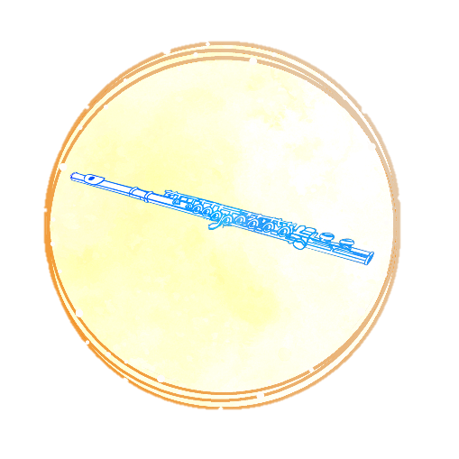
Sounds of God
Guessing Game

Slide 2



Slide 3
Single note of a flute

Slide 5
Thunder

Slide 7

Running Water

Slide 9
Violins

Slide 11
Tinkling Bells

Slide 13
Buzzing Bees

Slide 15

Wind

Slide 17
Roar of the Sea

Slide 19
Woodwind Instruments

