Slide 1
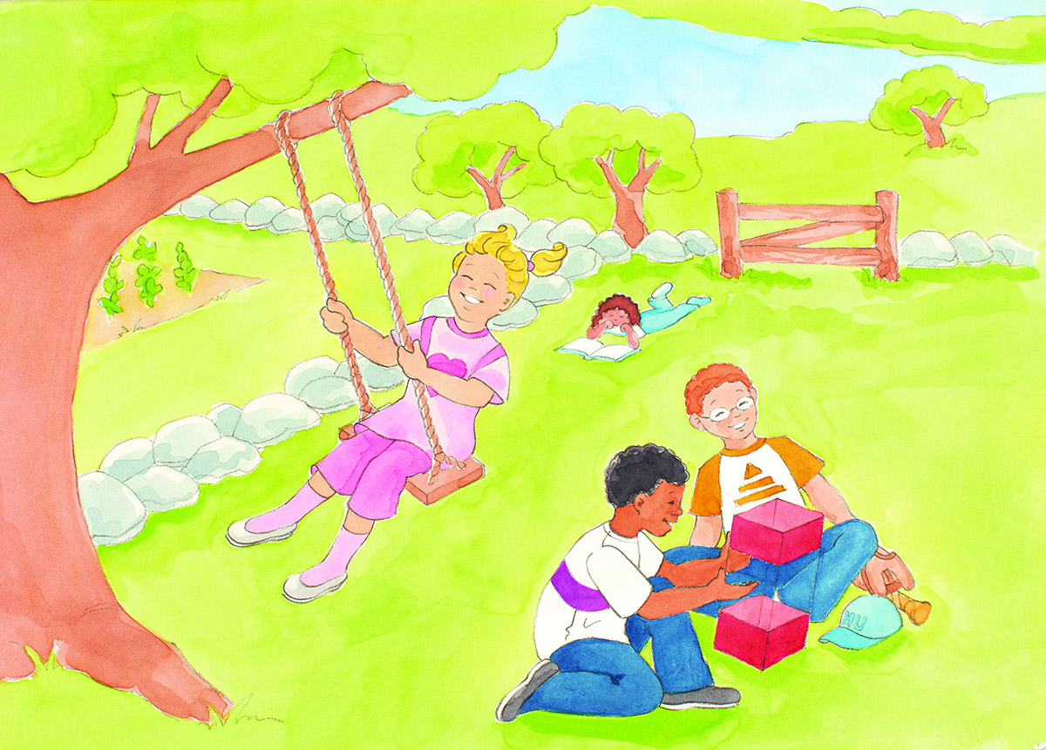
How ECK Helps Me
Click to enter date
Click to enter event

Slide 2
“ECK is love. ECK is Light and Sound. ECK is life!”
–The ECK Teenie 1 Discourses, p. 132

