Slide 1
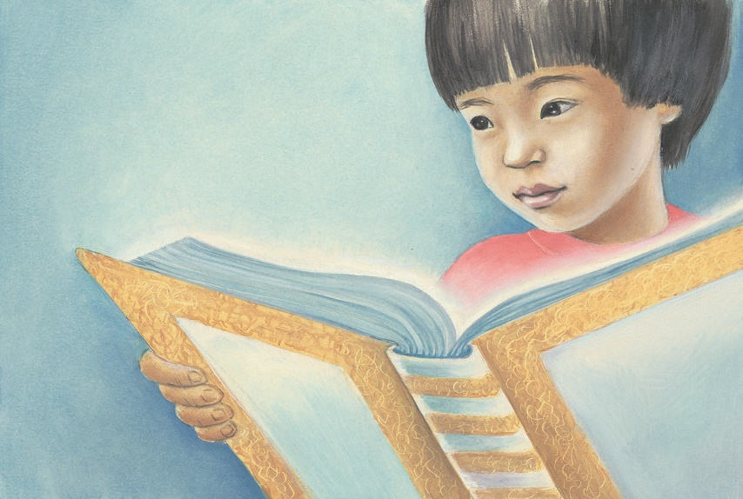
Special Forum for ECK Parents
Parenting with Grace and Creativity

Slide 2
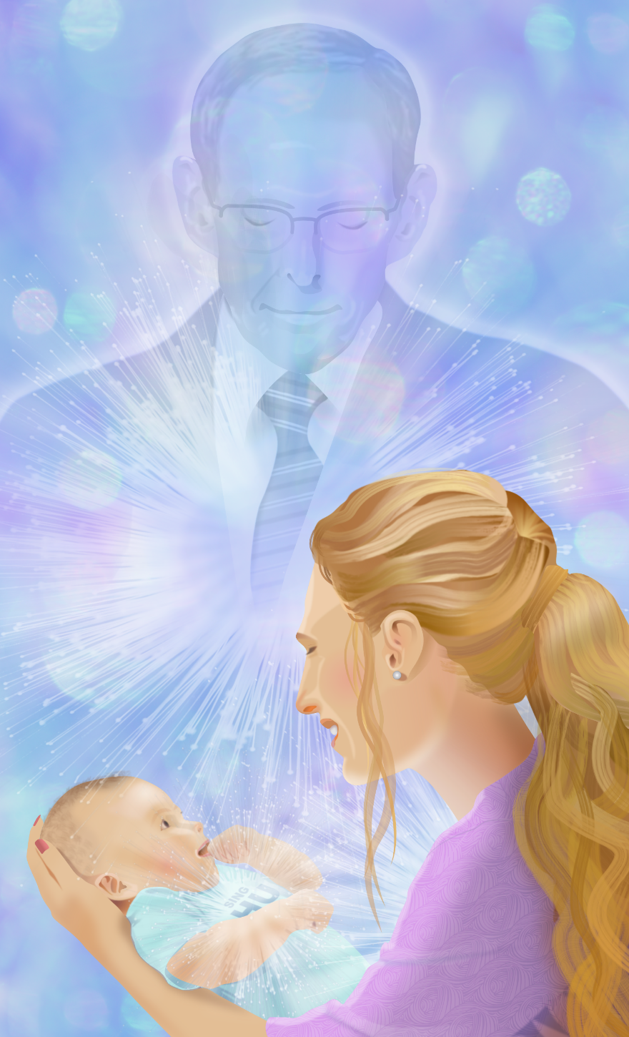
“Today we are setting the example for how the teachings of ECK will be taught in the future, how our children will teach their children.”
Sri Harold Klemp, How the Inner Master Works, p. 22

Slide 4
Parents can ask the Master their question!
ECKParents.org

Slide 5
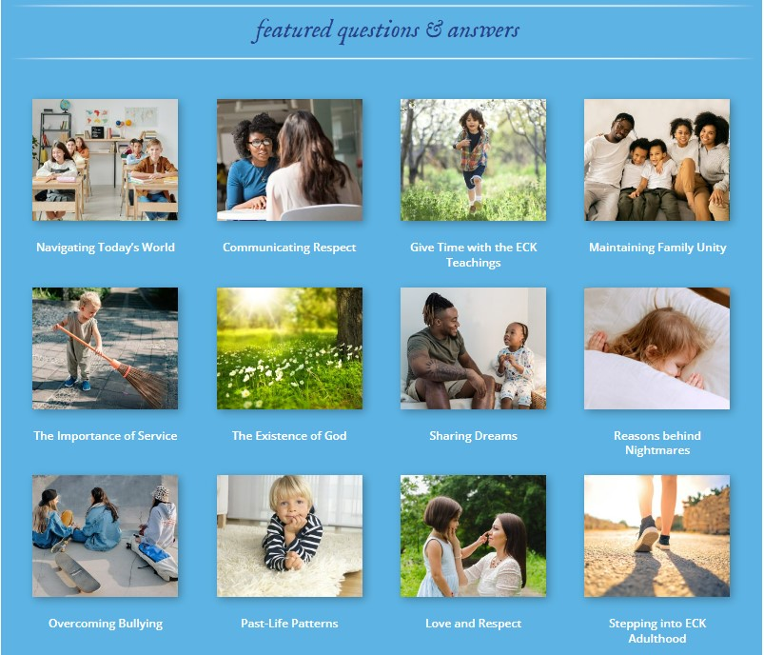

Slide 6
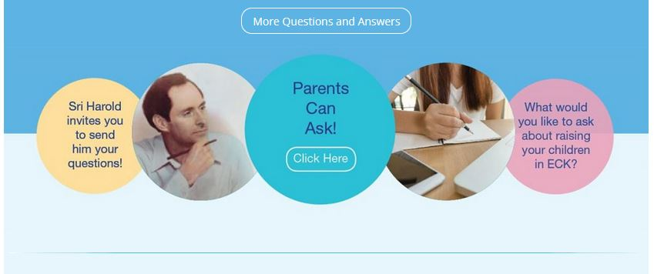

Slide 7
Table Discussions
Enjoy!
Helping our Children Balance Spirituality and Technology
Parenting Adolescents
I am the Only ECK Parent in my Family

Slide 8
Special Panel
Weaving the ECK Teachings into Our Children’s Everyday Lives

Slide 9
When I Was Big
“When you receive a subtle sign that helps you meet a problem, pass it along to [your children]. That is an ideal way to teach a highly useful spiritual talent that will outlast the latest electronic device.”
Sri Harold Klemp, The Mystic World, June 2019
Tip # 1

Slide 10
“Keep the Spiritual Exercises of ECK short, to fit the attention span of each child. Ask each to share inner experiences if so wished. And do family HU chants.
“Best, show your love for your children. And for the spiritual exercises.”
Sri Harold Klemp, A Modern Prophet Answers Your Key Questions about Life, Book 3, p. 77
Tip # 2

Slide 11
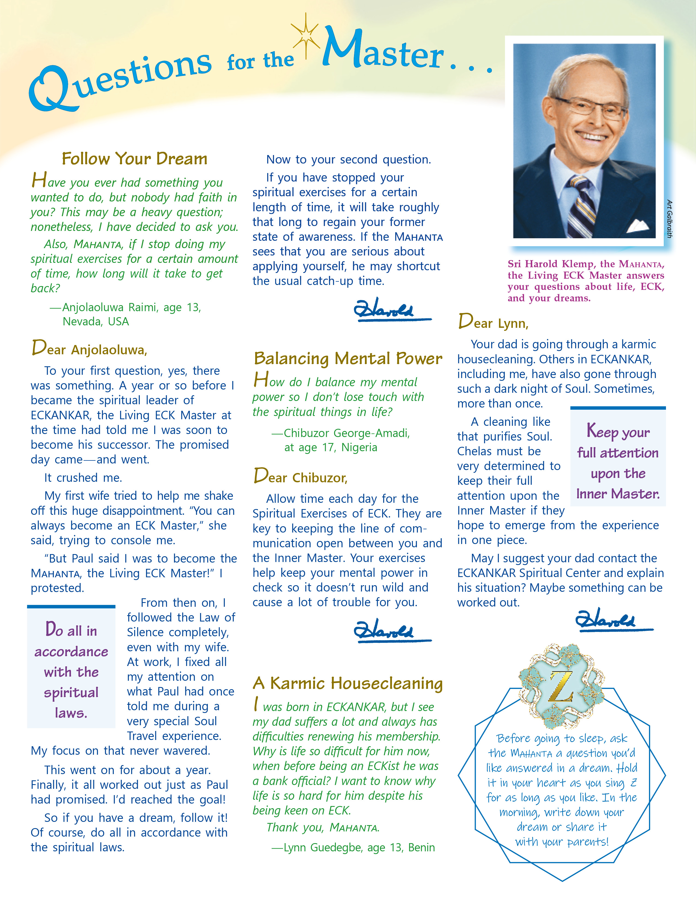
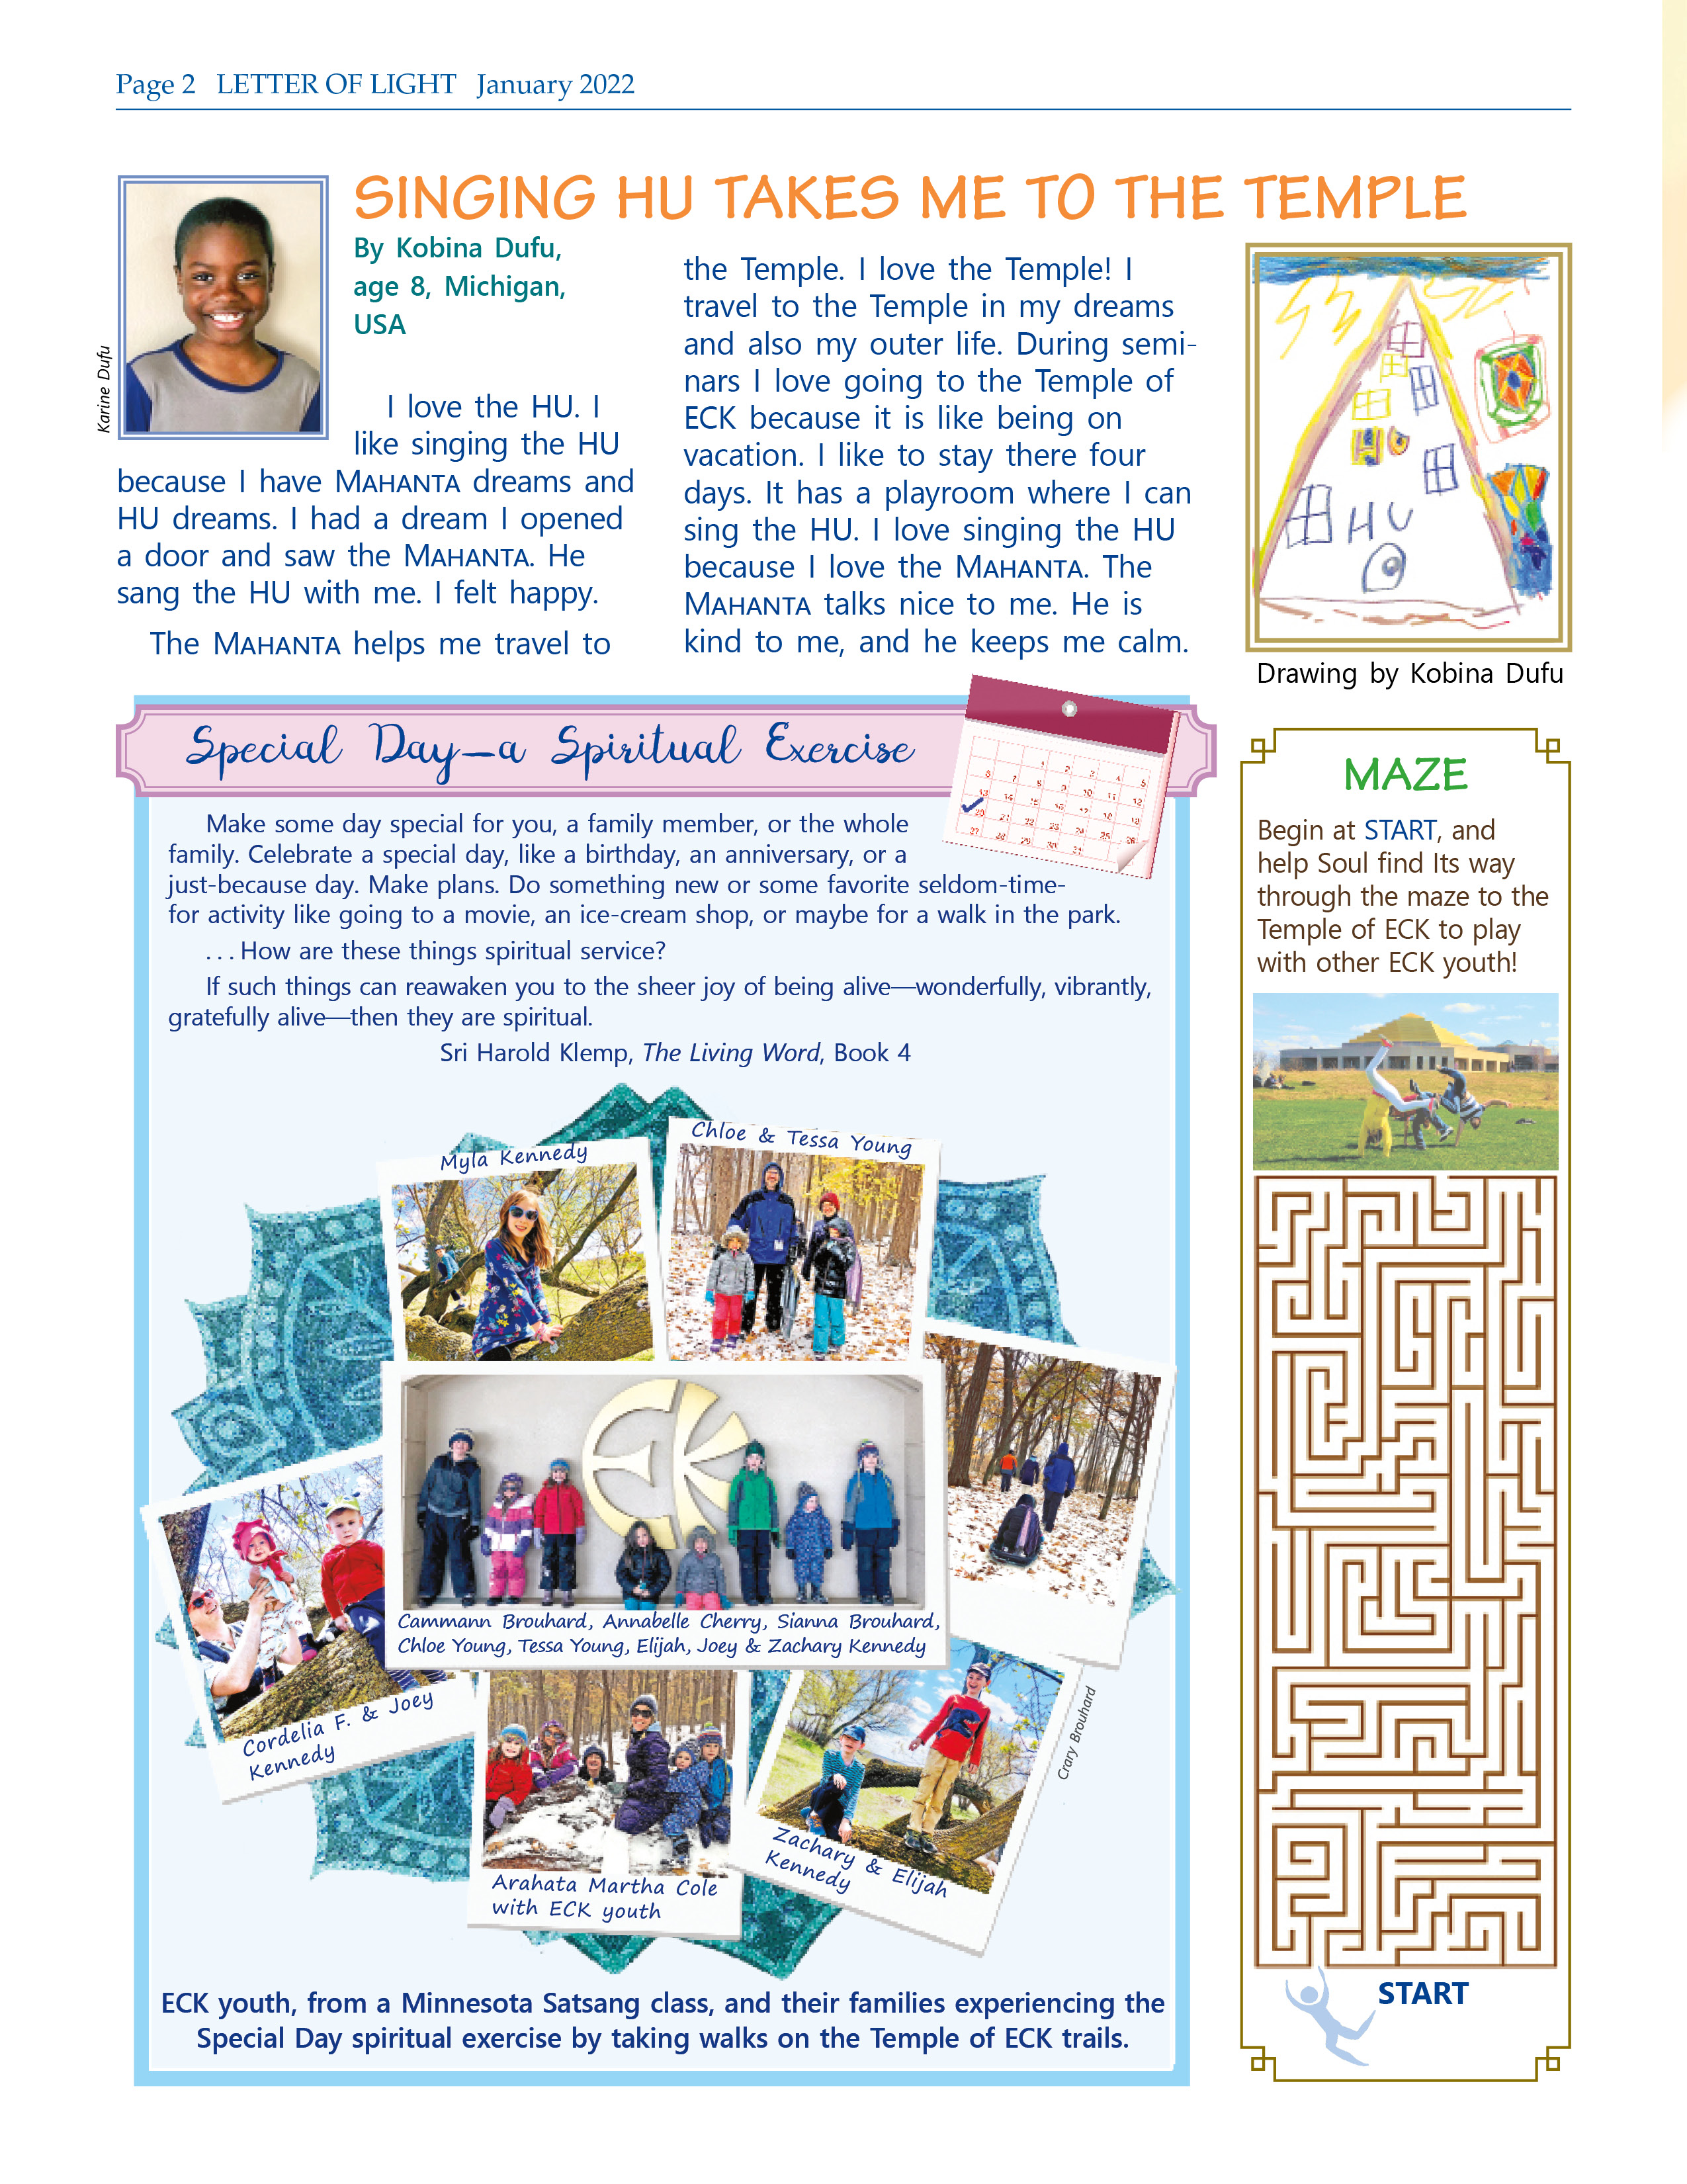
Youth can submit!
Letter_of_Light@Eckankar.org

Slide 12
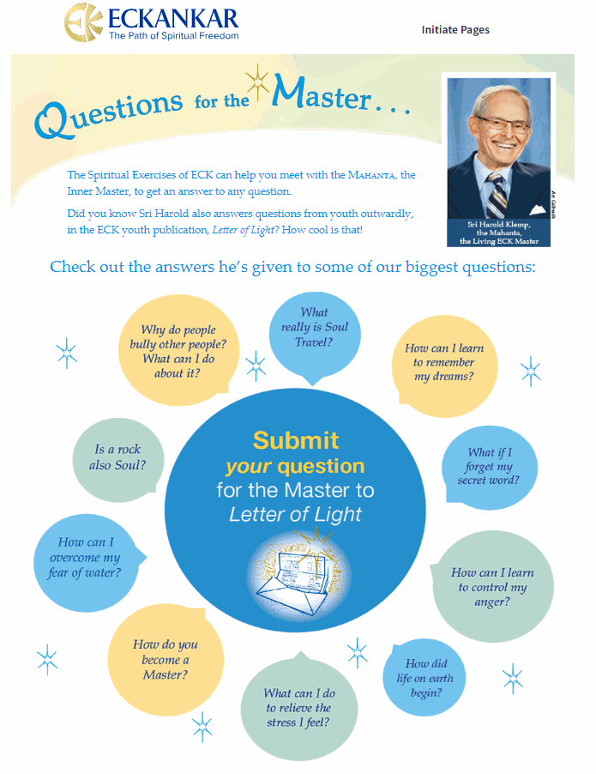
ECKyouth.org
Youth can ask the Master their question!

Slide 13
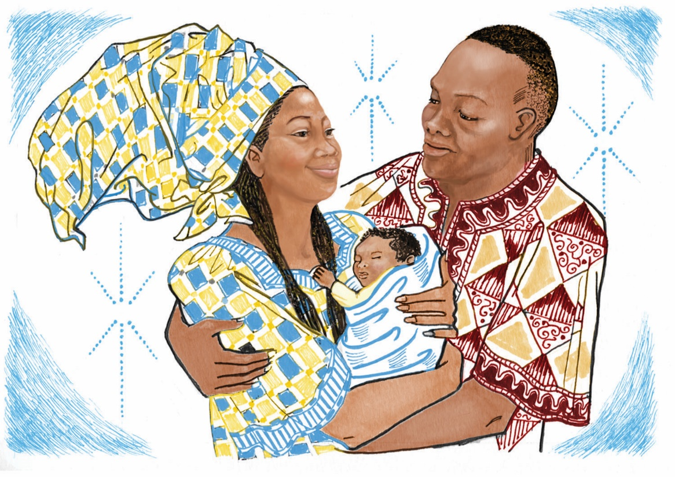
“As a reminder, everyone in a family has gathered in this lifetime to take advantage of the best possible circumstances for each to excel spiritually.”
Sri Harold Klemp, A Modern Prophet Answers Your Key Questions about Life, Book 3, p. 77

Slide 14
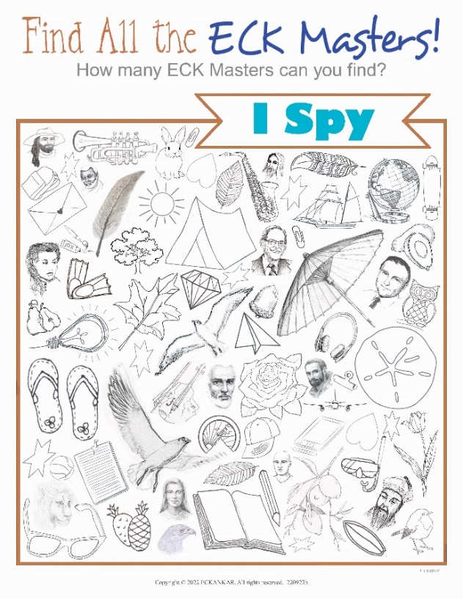
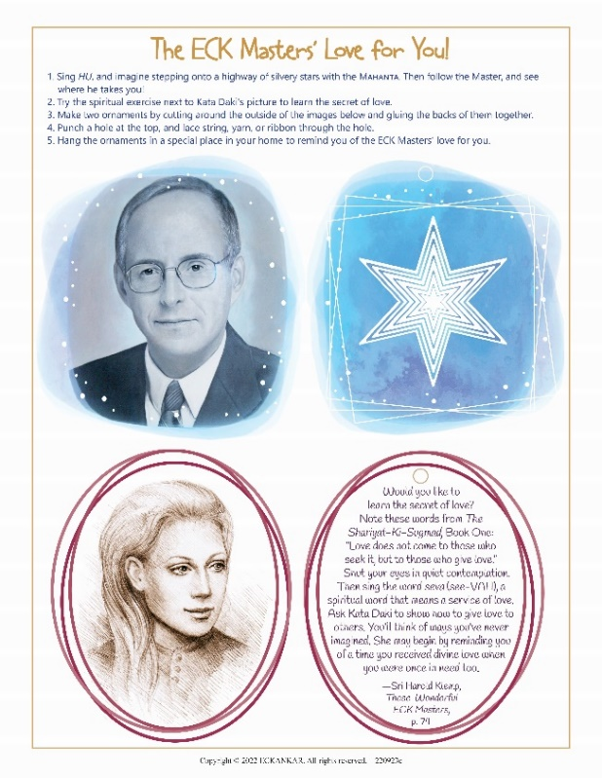
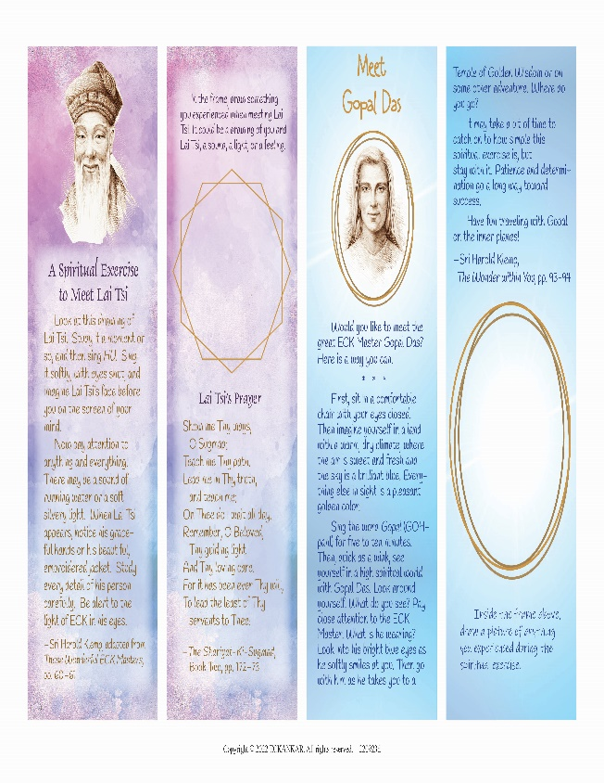
New Activity Sheets for Youth!

Slide 15
Thank you for coming!
We appreciate receiving
your feedback and ideas.

