Slide 1
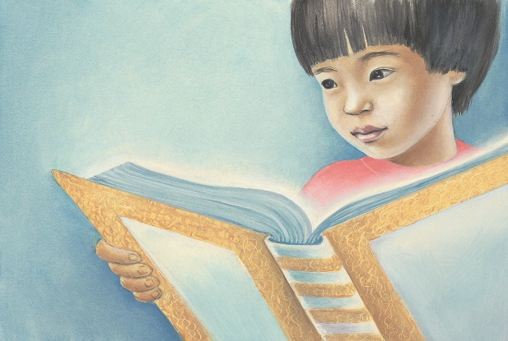
Special Forum for ECK Parents
Bringing the ECK Teachings
to Life for Our Youth

Slide 2
“The role of the parents is to show the children how to come to the temple within themselves, even when they’re young; to show them how to work with the sacred names of God and come to this Sound and Light of Divine Spirit. And it will take every bit of creativity that you have to learn how to work with children.” —Sri Harold Klemp, Journey of Soul, Mahanta Transcripts, Book 1, p. 180

Slide 3
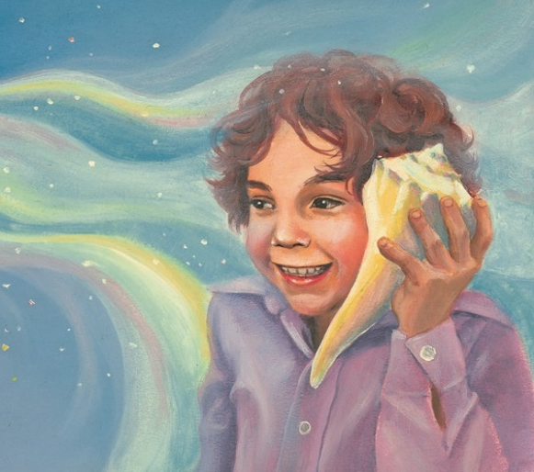
How do you use your creativity to share the ECK teachings with your child?

Slide 4
“Frankly, most of the children’s education comes from what the parents teach them and from what they see Dad and Mom doing as they’re growing up.” – Sri Harold Klemp

Slide 5
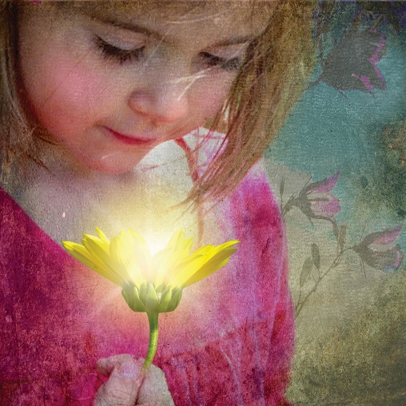
PANEL Helping Our Children Recognize the Gift of the ECK in Their Lives

Slide 6
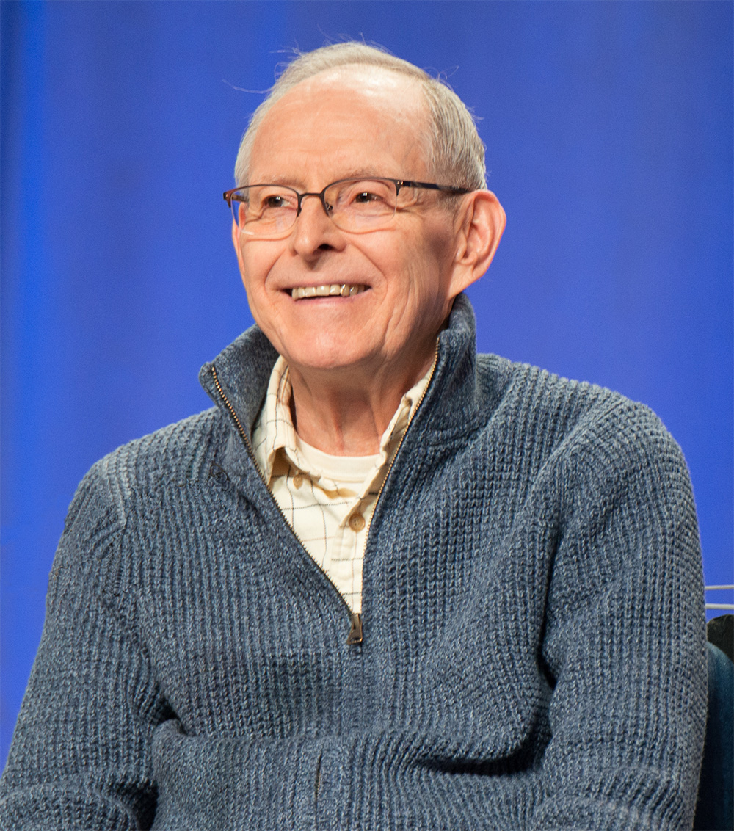
Sri Harold Klemp
1982 ECK European Seminar, “Questions and Answers”
Notes:
Audio Excerpt of Sri Harold from 1982 ECK European Seminar, “Questions and Answers,” on Saturday, July 31, 1982

Slide 7
Notes:
Audio excerpt of Sri Harold from 1982 ECK European Seminar, “Questions and Answers” on Saturday, July 31, 1982

Slide 8
New Resources!

Slide 9
ECK Parents Blog
ECKparents.org
adventuresinECKparenting.org

Slide 10
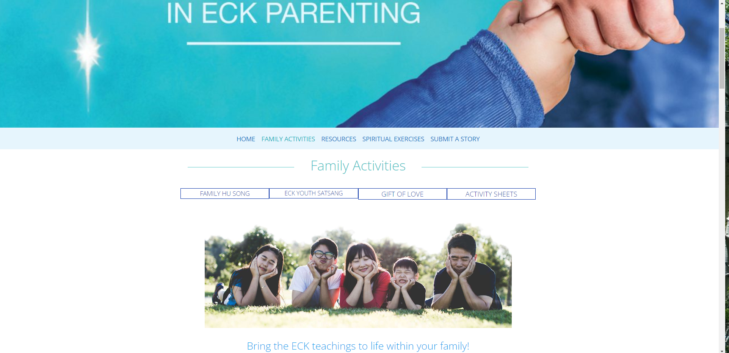
1.
2.

Slide 11
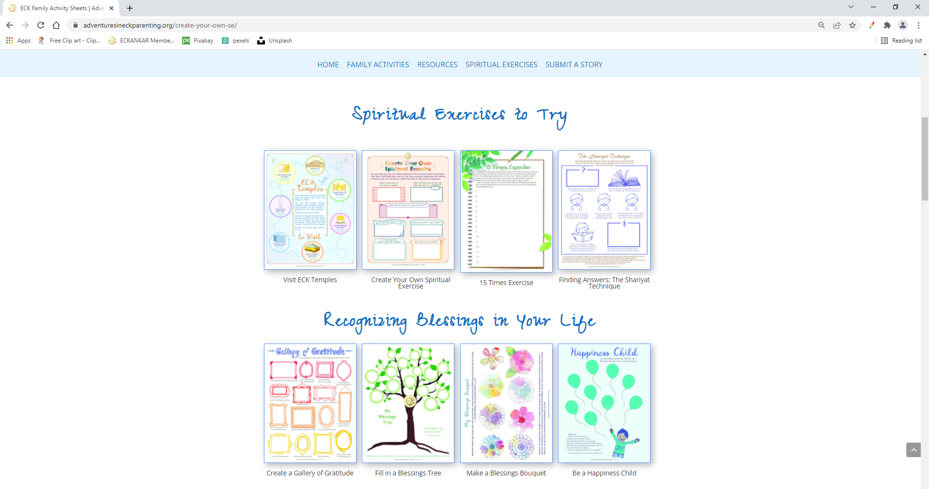
NEW Activities

Slide 12
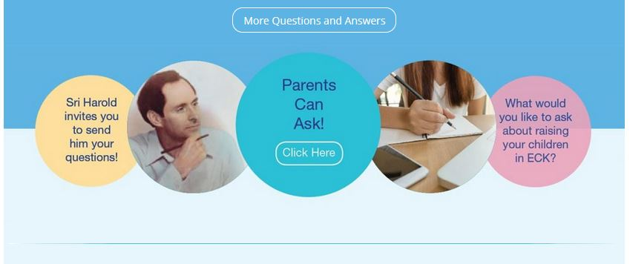

Slide 13
ECK Youth Webpage
Questions for the Master Section!
www.ECKyouth.org

Slide 14
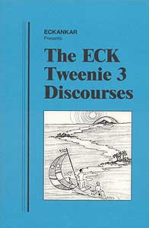
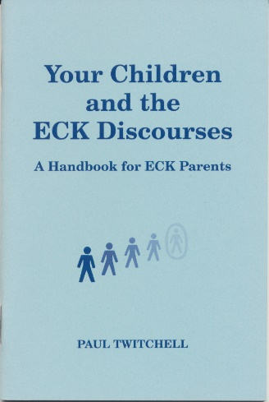
ECK Books and Resources Fair
NEW

Slide 15
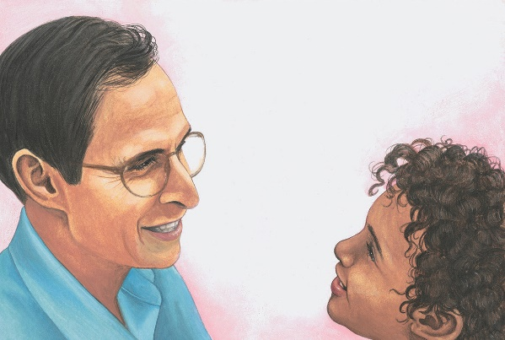
What spiritual exercises do you love to do with your child?
How do you or could you help your child personally connect with the Mahanta?

Slide 16
“Today we are setting the example for how the teachings of ECK will be taught in the future, how our children will teach their children.” – Sri Harold Klemp, How the Inner Master Works, Mahanta Transcripts, Book 12, p. 22

Slide 17
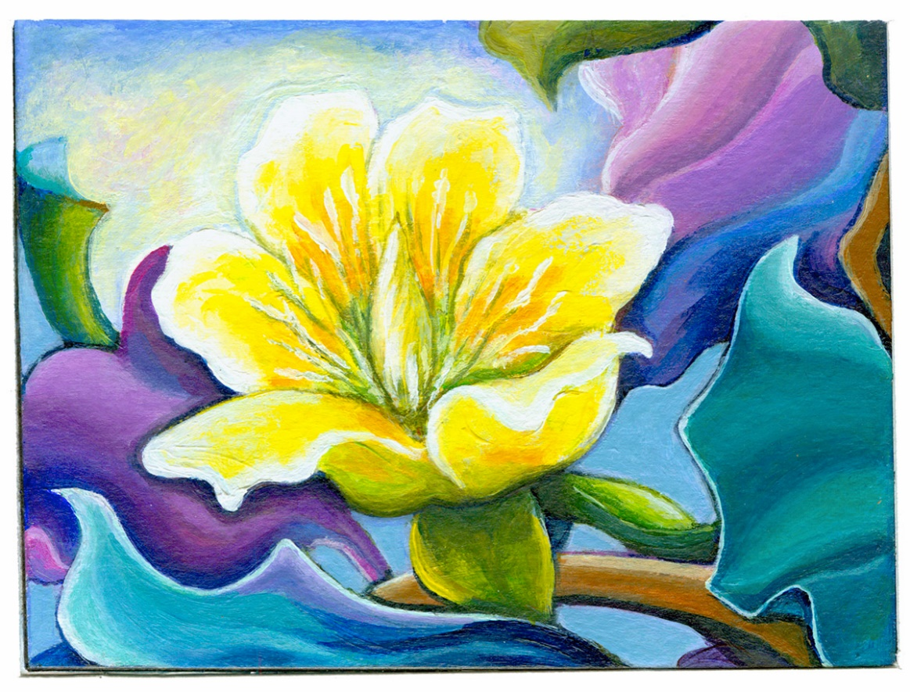
Thank you!
And thank you for filling out comment forms!

