Slide 1
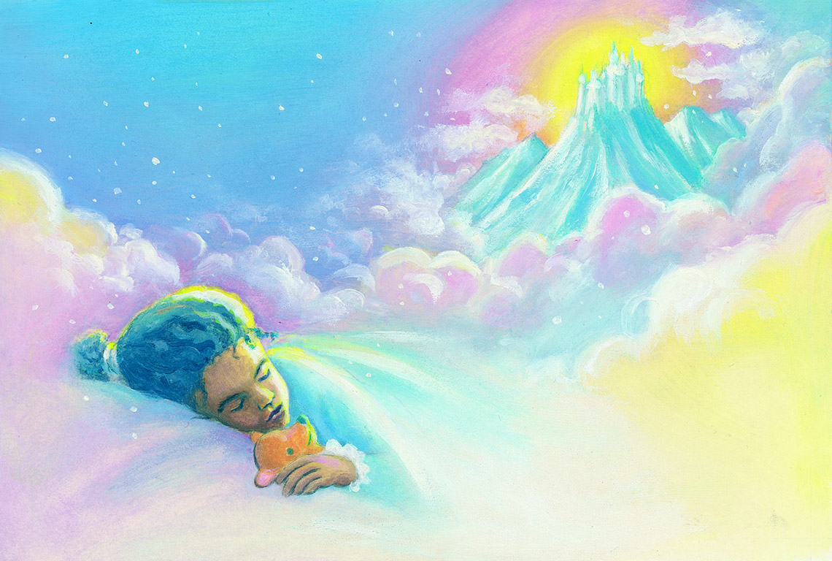
Your Family and the World of Dreams
Facilitators: Click here to add facilitators’ names

Slide 2
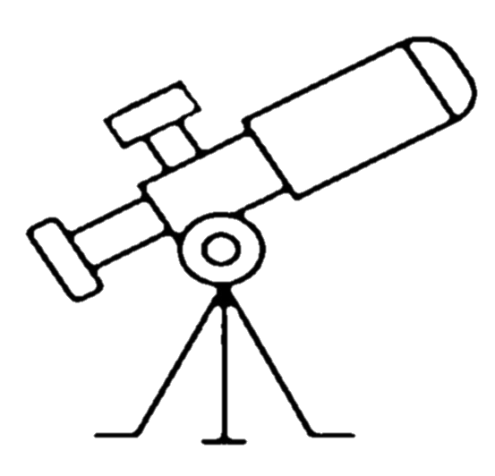
“Your dreams are like a telescope that can give a better view of something that is normally out of reach: your spiritual side. That includes how you act, feel, reflect, think, react, and even love.”
—Sri Harold Klemp, The Art of Spiritual Dreaming, p. 3

Slide 3
The Dream Master
Sri Harold Klemp, the Mahanta, the Living ECK Master

Slide 5
Insert “Dream Journeys” video clip (1:18 – 2:25)
From ECKANKAR website videos
Notes:
Video 1. Excerpt from Sri Harold’s 1995 ECK Worldwide Seminar talk, “The Most Secret Part of Yourself.” Excerpt found in Our Spiritual Wake-Up Calls, chapter 3 “The Most Secret Part of Yourself,” pp. 55-56

Slide 8
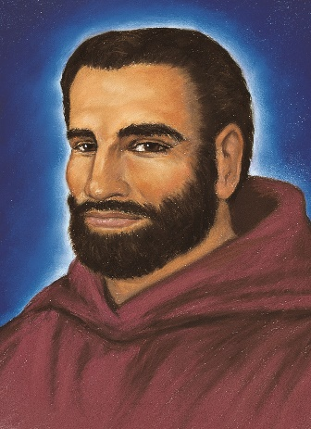
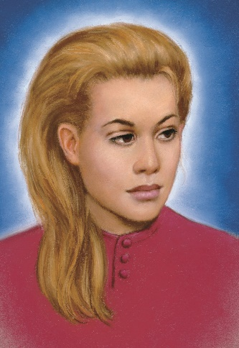
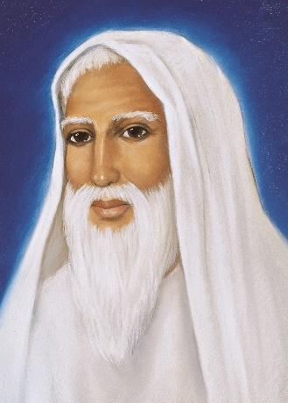
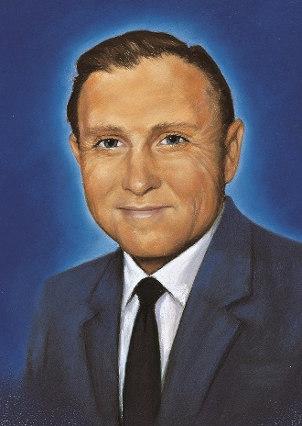
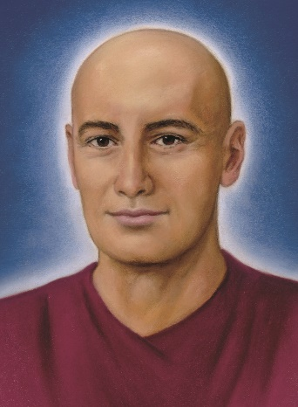
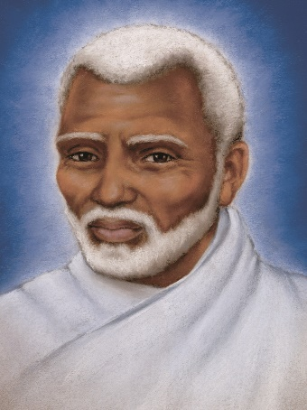
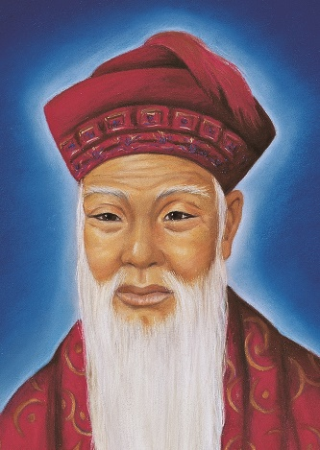
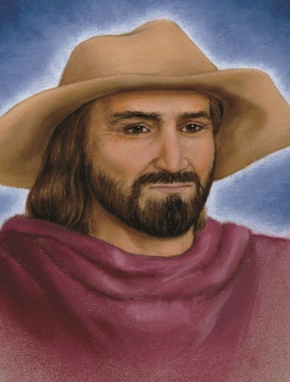
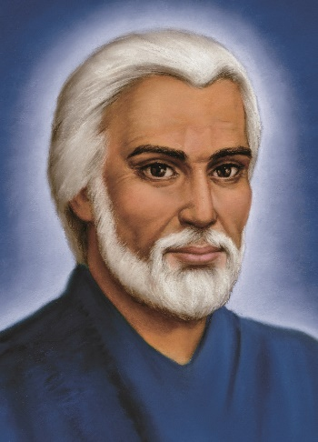
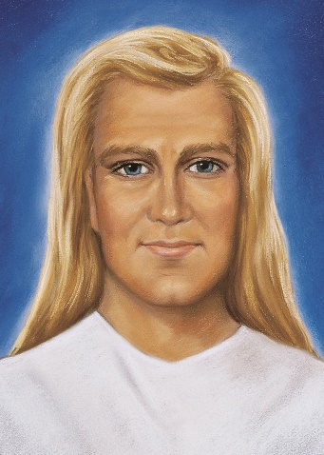

Slide 9
The Dream Dictionary
“Creating a dream dictionary can help you become familiar with your own dream symbols. Whether a baseball diamond, a bear, an eagle, or anything else, you’ll know immediately what a particular symbol means to you….

Slide 10
“As you create your own dream dictionary of symbols, record the date next to the meaning of each symbol. This way you can keep track as the meaning changes. As you unfold, your dream symbols are going to take on different meanings, a fact not generally known by people who study dreams.”
—Sri Harold Klemp, The Art of Spiritual Dreaming, p. 167

Slide 11
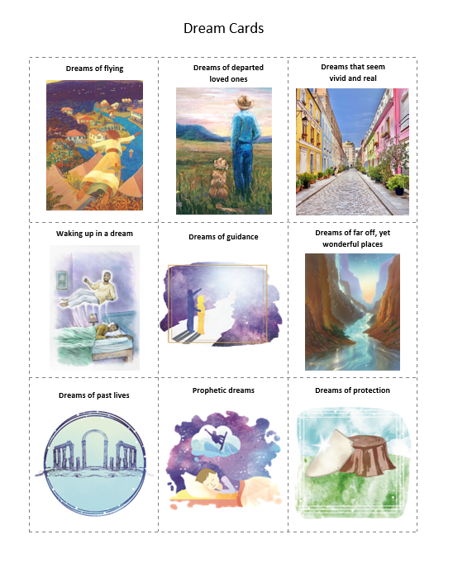
Dream Storyboard Exercise

Slide 12
“Dreams touch every level of our life. They may let us glimpse the future, or give suggestions for healing, or share insights into our relationships. Above all, they can and will steer us more directly toward God.”
—Sri Harold Klemp, The Art of Spiritual Dreaming, p. 2

Slide 13
Spiritual Exercise
Inviting the Dream Master

Slide 14
Thank you!

