Slide 1
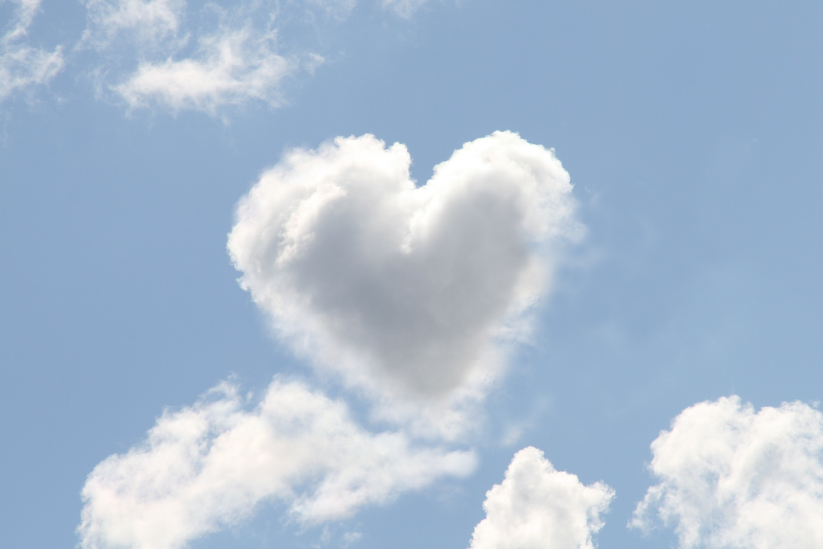
The Temple within
Your Heart
Click to enter event title and date

Slide 2
“There are a lot of holy temples out here, but the most sacred of all is the temple inside you, because this is where you meet with…God.”
–Sri Harold Klemp

